Slide 1





2018 Cancer Community Health Needs Assessment

Slide 2
Cancer Trends

Slide 3
Cancer Trends Across New York State
Table 1.
Site of Cancer | Number of Diagnosed Cancer Cases
 | 2012 | 2013 | 2014 | 2015 | 2016
Breast | 2237 | 2291 | 2038 | 1871 | 1596
Gastrointestinal | 6501 | 7135 | 6910 | 6849 | 6359
Gynecologic | 2155 | 2528 | 2095 | 1908 | 1665
Head & Neck | 2402 | 2478 | 2462 | 2204 | 2144
Skin | 143 | 169 | 175 | 168 | 148
Thoracic | 4081 | 4403 | 4227 | 4209 | 3863
Urologic | 2382 | 2378 | 2485 | 2439 | 2356
Other | 11156 | 11086 | 10906 | 10695 | 10387
Grand Total | 31057 | 32468 | 31298 | 30343 | 28518
Top Cancers:
Gastrointestinal
Thoracic
Urologic
Head & Neck
Gynecologic
Data Source: SPARCS 2012-2016 Hospital Inpatient Discharge data
Notes:
When evaluating cancer trends across New York State, there were a high number of gastrointestinal, thoracic, urologic, head & neck, & gynecologic cancer cases from 2012-2016. Gastrointestinal and thoracic cancer remained as the top two cancers. While urologic and head & neck cancer had relatively close numbers of cases across the years, this was followed by gynecologic cancer remaining as the top 5th cancer across NYS (when excluding “Other”).
On the next slide, we have included a graph further summarizing the data from this table.
Note: “Other” included the following cancer sites: bone & connective tissue, prostate, testis, other male genital organs, Hodgkin’s disease, non-Hodgkin’s lymphoma, leukemias, multiple myeloma, cancer; other & unspecified primary, and secondary malignancies.
Data Source: SPARCS 2012-2016 Hospital Inpatient Discharge data
Link: https://health.data.ny.gov/Health/Hospital-Inpatient-Discharges-SPARCS-De-Identified/u4ud-w55t

Slide 4
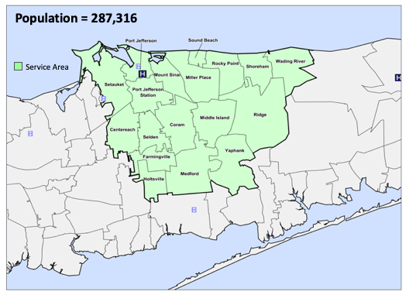
Cancer Community Health Needs Assessment
Sample: Residents of Suffolk County (N = 452)
Towns Surveyed:
Centereach
Coram
East Setauket
Farmingville
Holbrook
Holtsville
Medford
Middle Island
Miller Place
Mount Sinai
Patchogue
Port Jefferson Station
Port Jefferson
Rocky Point
Ronkonokma
Selden
Shoreham
Sound Beach
Stony Brook
Wading River
Ridge
Other
Notes:
When conducting our cancer community health needs assessment in Suffolk County, it should be noted that our sample consisted of 452 Suffolk County residents, who reported living in the towns described in the above slide. The greatest frequency of responses came from Coram (8.41%) followed by Port Jefferson Station (6.23%), Port Jefferson (6.23%), East Setauket (5.92%), Middle Island (5.61%), and Selden (5.61%).
Please note that a large number of participants did not identify which town they lived in (N = 131).

Slide 5
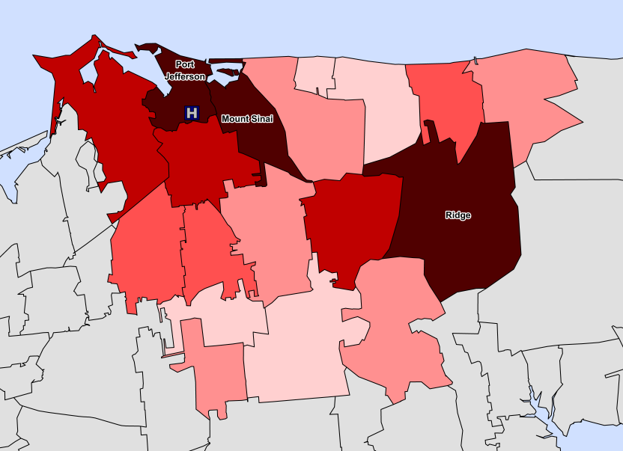
Mather Service Area Cancer Discharge Rate
All Cancer
Top 20%
21% to 40%
41% to 60%
61% to 80%
Source: SPARCS ver2017.10.20;
Includes all aged patients; Discharges/1000 is calculated as ((total 5-year cancer volume)/population)*1000
Prepared by the Office of Strategic Planning/mac
81% to 100%

Slide 6
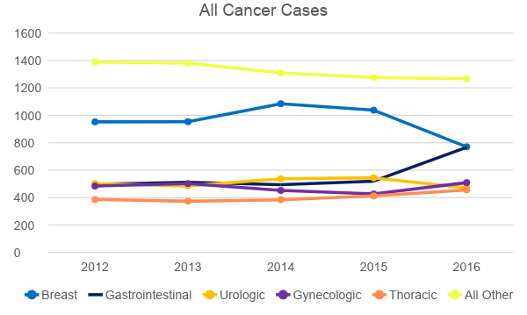
Top 5 Prevalent Cancers: Primary Service Area
Top Cancers:
Breast
Gastrointestinal
Urologic
Gynecologic
Thoracic
Source: SPARCS ver2017.10.20;
Includes all aged patients; ¹Thoracic includes lung cancer; Grand Total includes all cancer cases/specialties. Prepared by the Northwell Health Office of Strategic Planning/mac
Notes:
Here we have included another graph summarizing All Cancer Cases from the Mather Service Area.
In terms of cancer trends, we can infer that the order of the top 5 cancers across Suffolk County includes: (1) Breast; (2) Gastrointestinal; (3) Gynecologic; (4) Urologic; (5) Thoracic.
Such trends are in line with that of New York State (See Slide 2).
Overall, the above graph shows that...
The number of breast cancer cases increased from 2012 (n= 952) to 2014 (n=1084). However, from 2014 to 2016, the number of breast cancer cases declined (from n=1084 in 2014 to n=770 in 2016).
When looking at gastrointestinal cases, we can see that it was variable. There was a notable increase in gastrointestinal cases from 520 in 2015 to 766 in 2016.
The number of urologic cases was variable. We can see that the highest number of cases occurred in 2015 (n=544), followed by a decline in 2016 (n=471).
The number of gynecologic cases was also variable. While the number of cases decreased from 502 in 2013 to 426 in 2015, there were additional cases by 2016 (n=509).
The number of thoracic cases generally increased across the years from 2012 (n=386) to 2016 (n=456).
The number of other cancer cases generally declined across the years from 2012 (n=1388) to 2016 (n=1266).
Data Source: Tables from Pg 4 of Mather Hospital Cancer Community Health Needs Assessment Packet (February 11, 2019)

Slide 7
Top 5 Prevalent Cancers: Mather Hospital
Cancer Subclasses – Inpatient and Ambulatory Surgery
Source: SPARCS ver2017.10.20;
Includes all aged patients; ¹Thoracic includes lung cancer; Grand Total includes all cancer cases/specialties
Prepared by the Office of Strategic Planning/mac

Slide 8
Top 5 Prevalent Cancers: St. Charles Hospital
Cancer Subclasses – Inpatient and Ambulatory Surgery
Source: SPARCS ver2017.10.20;
Includes all aged patients; ¹Thoracic includes lung cancer; Grand Total includes all cancer cases/specialties
Prepared by the Office of Strategic Planning/mac

Slide 9
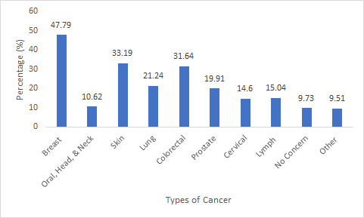
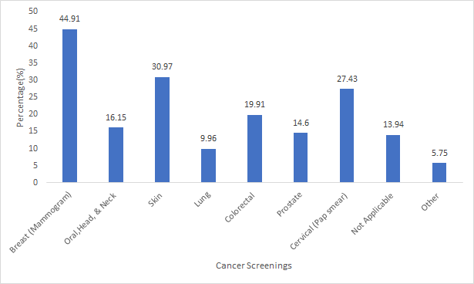
Survey Repondents
Cancer Status and Screenings
45.36% of participants reported having ever been diagnosed with cancer
Cancer Type | Percentage Diagnosed
Breast | 13.50
Oral, Head, & Neck | 2.21
Skin | 11.95
Lung | 3.76
Colorectal | 2.21
Prostate | 6.42
Cervical | 1.33
Lymphoma | 1.77
Other | 12.17
Not Applicable | 62.83
Figure 5: Percentage of participants who express cancer concern
Figure 6: Percentage of participants who received a cancer screening within the past 12 months.
Notes:
45.35% of our participants reported having ever been diagnosed with cancer. Of the cancer diagnoses, breast cancer (13.50%), followed by other types of cancer (12.17%), and skin cancer (11.95%), were the most prevalent in this sample.
Figure 5: Greatest cancer concern was expressed for breast, skin, and colorectal cancers. On the other hand, only 10.62% of participants’ were concerned with oral, head, and neck cancer. 9.73% of participants expressed no concern.
Figure 6: Participants reported receiving breast, skin, and cervical cancer screenings the most. Fewer received oral, head, and neck, as well as, lung and prostate screenings.
While we previously identified the Mather Service Area Top 5 Cancers (Slide 8) to be (1) Breast; (2) Gastrointestinal; (3) Gynecologic; (4) Urologic; and (5) Thoracic, it can be seen that the cancers reported from our survey (i.e. with a majority of individuals reporting breast cancer and other cancer) were somewhat in line with the rest of Suffolk County.
Considering how breast cancer represents 20.8% of all cancer treatment within the Mather Service Area, it made sense that majority of participants expressed breast cancer concern (47.79%) and received breast cancer screening (44.91%).

Slide 10
Barriers and Recommendations

Slide 11
Barriers
Health Disparities
Healthcare Accessibility
Race & Ethnicity
Age
Gender
Socioeconomic Status
Access to Care
Barriers to Care
Notes:
When examining individuals across the Mather-St. Charles service population…
The CHNA survey allowed for the identification underserved groups, factors contributing to health disparities (i.e. race & ethnicity, age, gender, and socioeconomic status), in addition to barriers in healthcare accessibility.

Slide 12
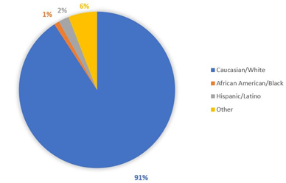
Race and Ethnicity
Small % of minorities reported
  Not a primary factor influencing disparity in these hospitals
However, survey limitations may have biased results
  Restricted hospitals’ abilities to identify barriers affecting diverse Suffolk County populations
Survey Suggestions Under Review
Expand sampling methods (i.e. distributing in-person surveys or mailed surveys)
Offer additional language options
Figure 7: CHNA Survey: Participant Race/Ethnicity
Notes:
Race & Ethnicity
In many underserved communities, race and ethnicity remain as the main drivers of health disparities. This is often observed among White, African American, and Hispanic individuals, where the latter two groups are more likely to experience worsening chronic health conditions.¹
In this survey, only 10% of participants identified themselves as African American (1.08%), Hispanic or Latino (2.17%), and Other (5.94%); the remaining participants identified themselves as Caucasian (90.79%) (Figure 7).
Although this survey identified there to be a small minority population, it is important to realize that there are other systematic inequalities that can influence individuals’ health outcomes. For example, DeRuy (2019) noted health care system knowledge, health insurance, and culturally competent providers to be factors impacting individuals’ care.
In this instance, race and ethnicity alone may not have been the driving factors influencing health disparities across the Mather-St. Charles service population; rather, they may have been relevant for the minority individuals within the CHNA survey.
Survey Limitations
Considering how the CHNA survey was distributed via email in one language format (i.e., English), it was possible that the survey did not reach all Suffolk County residents:
Individuals may have faced issues in accessibility (i.e. lack of access to internet/computer)
Individuals may have not understood the survey language
Such survey limitations may have in turn biased the results, thereby restricting hospitals’ abilities to identify barriers affecting the Suffolk County populations
Survey Suggestions
In order to reach a greater number of individuals within the Mather-St. Charles service area, future CHNA surveys should expand their sampling methods (i.e., distributing in-person surveys or mailed surveys) while offering additional language options

Slide 13
Age
Approximately 63% of participants reported to be 61 years of age or older
Sources of disparity associated with old age
  Fear of results
  Cost burdens
Consequences
  Delays in seeking medical attention
  Underutilization of preventative care services (i.e., cancer screenings, immunizations)
Suggestions Under Review
  Distribution of information on treatment costs, preventative care services, and alternative financial plans
Notes:
Previous studies have reported age to be another factor contributing to health disparities. Often, with the increased cost burdens associated with old age, many elderly persons delay seeking medical attention.^{3,4}
Despite the passing of the Affordable Care Act (ACA) in 2010, which granted older adults access to additional preventative care services such as cancer screenings and immunizations, many of these services have remained underutilized. ⁵
Aside from a fear of results, elderly persons may be afraid to seek preventative care services due to the accruing costs associated with co-pays and out-of-pocket expenses.
In order to reduce age-related health inequalities, hospitals can work with public health officials and reevaluate the ways in which they communicate with elderly persons. By providing older adults with information on treatment costs, preventative care services, and alternative financial plans (to assist in their utilization of healthcare services), this can function to improve their future well-being.

Slide 14
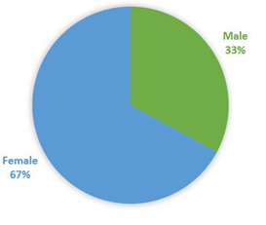
Gender
Factors affecting life expectancy gap since birth
Higher female mortality
  Rises in opioid use, obesity, and smoking related diseases
Higher un-insurance rates among men
  Limitations in access to preventive services (i.e. cancer screenings) and quality care
Suggestions Under Review
Distribute information about free or reduced-cost preventative care services
Figure 8: CHNA Survey: Participant Gender
Notes:
In terms of gender, approximately 67% of participants identified themselves as female while 33% of participants identified themselves as male (Figure 8). Previous studies have suggested gender to also be a factor contributing to the experience of health disparities within a given community.
In 2018, research found there to be a gap in the life expectancy at birth between U.S. women and men; women typically lived five years longer (81 years) when compared to men (76 years). Although the life expectancy gap since birth has narrowed over time, the reasons behind this trend are concerning. Female mortality, especially with regards to White women, has increased due to rises in opioid use, obesity, and smoking-related diseases.⁷ Additionally, following the implementation of ACA, men have been reported to have higher un-insurance rates. Consequently, men have experienced limited access to routine preventative services (i.e., cancer screenings) and quality care.⁸
Since men are more likely to experience reduced health care access and utilization, efforts should be made to reach out and inform men about free or reduced cost preventative services offered by Mather and St. Charles hospitals.

Slide 15
Socioeconomic Status
Participants’ SES
  5% of participants reported needing government assistance such as SNAP, Medicaid, or Section 8 housing
  3.8% of participants were unemployed
  7.16% of participants reported earning an income below the federal poverty level
Previous research finds that…
1 out of 4 adults experience food insecurity (HWCLI)
34% of Suffolk County residents are not eligible for SNAP or other Nutritional Assistance Programs (Long Island Collaborative)
Suggestions Under Review
  New Hospital Incentives
      Free meals → preventative care services
Notes:
Although a majority of the participants within the Mather-St. Charles service area were retired and did not rely upon federal assistance, it could be seen that there was still a small percentage of participants who faced financial hardships. While attempting to prioritize basic food/housing needs, these individuals may have been limited in their ability to seek healthcare services.
According to HWCLI, 25 % of all Long Island households struggle to pay for housing, food, clothes, transportation, and health care.
Moreover, one in four adults experience food insecurity and 34% of individuals who reside in Suffolk County do not qualify for SNAP benefits or other Nutritional Assistance Programs.
Thus, in order to reduce the health disparities associated with low socioeconomic status, new community outreach initiatives are required.
The hospitals may consider providing incentives such as free meals in order to encourage the use of preventative care services.

Slide 16
Healthcare Accessibility
96.68 % of participants reported being able to see a doctor when necessary
The top sources for participants’ healthcare needs included:
  Physicians’ offices (96.68%)
  Urgent care/walk in clinics (10.18%)
Patient Accessibility Issues
  Lack of knowledge
Suggestions Under Review
  Patient Education
    Detailed discussions with physicians
    Informational pamphlets
Notes:
While a majority of participants reported being able to see a doctor when necessary, most participants reported receiving care at physicians’ offices (96.68%). Only 10.18% of participants reported receiving care at urgent care/walk in clinics; meanwhile, a smaller percentage of individuals reported using the Emergency Department, community health clinics, as well as other sources of care not listed in the survey.
Considering how a majority of individuals relied upon private practices for their healthcare needs, this could have occurred due lack of knowledge about alternative options for care.
In this instance, medical professionals may consider having detailed discussions with their patients about alternative healthcare facilities. Professionals may distribute informational pamphlets describing where individuals can go to address their immediate medical needs. This in turn can function to reduce gaps in healthcare accessibility.

Slide 17
Barriers to Care
Participant barriers to routine healthcare included those related to:
  Appointment times
  Wait times at doctors’ offices
  Treatment costs
Participant barriers to cancer screenings included those related to:
  Lack of screening knowledge (e.g., unaware of necessity or where to obtain them)
  Appointment Times
  Fear
Suggestions Under Review
  Expansion of Service Hours
  Promotion of Telehealth Services
  Patient Empowerment
Notes:
Commonly cited barriers to participants’ routine healthcare included those relating to appointment times. For example, 7.08% of participants reported appointment times to interfere with other daily activities such as work. 6.19% of participants reported no appointments being available. Another barrier to receiving routine care included one relating to treatment costs. 4.87% of participants reported that they were unable to pay copays/deductibles and 4.65% noted that insurance did not cover the cost of treatment. However, it should be noted that 78.98% of participants reported our listed survey barriers as not being applicable to them.
When evaluating barriers pertaining to cancer screenings, common issues related to lack of screening knowledge. For example, 4.65% of participants reported being unaware of the necessity of the screenings. 3.54% of participants reported being unsure of where to obtain screenings. Other reasons included those relating to appointment times. 2.64% of participants reported to have forgotten or lost track of screening appointments and 1.55% of participants reported the appointment times to be inconvenient. Having a fear of results was also another factor preventing participants from obtaining cancer screenings, as reported by 1.77% of participants. However, it should be noted that 13.94% of participants reported none of the answer choices to be applicable to them.
In order address these limitations, the hospitals can consider providing alternative methods of care for their patients. Such methods may include the expansion of service hours (to include additional appointments) as well as promoting the use of Telehealth services (which can function as a cost-effective alternative approach in improving healthcare access). In order to further alleviate patients’ fears and uncertainties about cancer care, healthcare professionals can discuss procedures in a step-by-step manner, highlighting the importance of preventative care screenings. In doing so, patients may feel more empowered with regards to their healthcare decisions, and subsequently, become more motivated in utilizing the preventive healthcare services available to them.

Slide 18
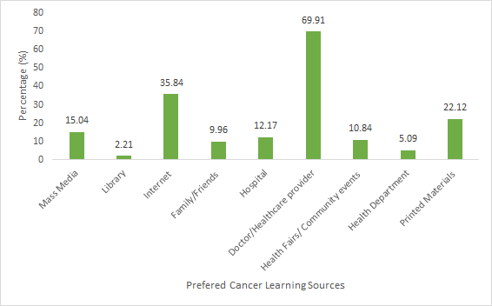
Survey Respondents:
Community Learning
Top Learning Source Preferences:
Doctor/Healthcare Provider
Internet
Printed Materials
Figure 9: Participants’ preferences for cancer learning sources
Notes:
When assessing Suffolk community learning preferences we found that…
Participants expressed the highest preference for learning about cancer from their doctor/healthcare provider (69.91%) and the internet (35.84%). However, the lowest preference was attributed to the library (2.21%), the health department (5.09%) and family/friends(9.96%).
Although public outreach resources are readily available, the study results suggest that these may not be the best ways to inform the public, as most would prefer to learn from healthcare professionals.

Slide 19
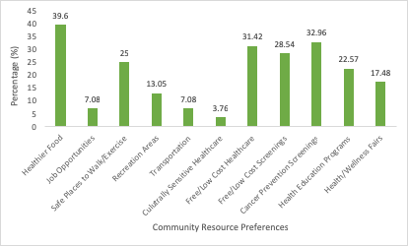
Survey Respondents:
Community Resources
Top Community Resource Preferences:
Healthier Food
Cancer Prevention Screenings
Free/Low Cost Healthcare
Figure 10: Participants’ preferences for community resources
Notes:
Participants highest community resource preferences included those relating to healthier food (39.6%), cancer prevention screenings (32.96%), and free/low cost healthcare (31.42%). Other notable community resource preferences included having free/low cost screenings (28.54%), health education programs (22.57%), and health/wellness fairs (17.48%).

Slide 20

Areas for improvement, enhancement, and future directions
Recommendations
Outreach Plan
Special focus on those communities with the highest cancer rates
Create communication media based on how the community wants to learn (internet, print, engage providers)
Speak to the issues import to community (why screening is important, alleviating fear)
Measure before and after to assess impact (# people opened an email made an appt., screening vol.)
Community Learning
Community Resources
Communication Efforts

Slide 21
References
Health.ny.gov.https://www.health.ny.gov/health_care/managed_care/reports/docs/demographic_variation/demographic_variation_2017.pdf. Published 2019. Accessed February 24, 2019.
Emily DeRuy N. 6 Key Health Disparities Between Blacks and Whites. The Atlantic. https://www.theatlantic.com/politics/archive/2015/10/6-key-health-disparities-between-blacks-and-whites/433056/. Published 2019. Accessed February 24, 2019.
Yamada T, Chen C, Murata C et al. Access Disparity and Health Inequality of the Elderly: Unmet Needs and Delayed Healthcare. Int J Environ Res Public Health. 2015;12(2):1745-1772. doi:10.3390/ijerph120201745
Goal F: Understand health disparities and develop strategies to improve the health status of older adults in diverse populations. National Institute on Aging. https://www.nia.nih.gov/about/aging-well-21st-century-strategic-directions-research-aging/goal-f-understand-health. Published 2019. Accessed February 24, 2019.
Older Adults | Healthy People 2020. Healthypeople.gov. https://www.healthypeople.gov/2020/topics-objectives/topic/older-adults#4. Published 2019. Accessed February 24, 2019.
Average life expectancy* in North America for those born in 2018 g. Life expectancy in North America in 2018 | Statistic. Statista. https://www.statista.com/statistics/274513/life-expectancy-in-north-america/. Published 2019. Accessed February 24, 2019.
Astone NM, Martin S, Aron L. Death rates for U.S. women ages 15-54. Washington, DC: Urban Institute; 2015.
NASEM. Improving the health of women in the United States: Workshop summary. Washington, DC: The National Academies Press; 2016a.
Hunger | Health and Welfare Council of Long Island (HWCLI). Hwcli.com. http://www.hwcli.com/tag/hunger/. Published 2019. Accessed February 26, 2019.
Collaborative L. Food Insecurity Impacts Long Island. Lihealthcollab.org. https://www.lihealthcollab.org/news-and-blog/the-major-impact-of-food-insecurity-on-long-island. Published 2019. Accessed February 26, 2019.
Care for Millions at Risk as Community Health Centers Go Over Funding Cliff. Commonwealthfund.org. https://www.commonwealthfund.org/blog/2017/care-millions-risk-community-health-centers-lose-billions-funding. Published 2019. Accessed February 26, 2019.
Belachew S, Mekuria A, Erku D. Preferred Information Sources and Needs of Patients With Cancer on Disease Symptoms and Management: A Cross-Sectional Study. J Glob Oncol. 2017;3(2_suppl):2s-2s. doi:10.1200/jgo.2017.009399
Shea-Budgell M, Kostaras X, Myhill K, Hagen N. Information needs and sources of information for patients during cancer follow-up. Current Oncology. 2014;21(4):165. doi:10.3747/co.21.1932

